Slide 1
How to make items be non-circulating (not for loan)
Yoel Kortick
Senior Librarian

Slide 2
Introduction
Define an item policy "Not for loan"
Define a terms of use (TOU) "Not for loan"
Make a fulfillment unit rule connected to the TOU and policy
Test it out

Slide 3
Introduction

Slide 4
Introduction
Here we will show how to make items which have a certain attribute be non circulating.
That attribute might be, for example according to library, location, the user group who tries to loan the item, item policy, etc.
In the example here we will make an item policy called "Not for loan" and then attribute that item policy to terms of use which does not allow loaning.

Slide 5
Define an item policy "Not for loan"

Slide 6
Define an item policy "Not for loan"
Go to: "Configuration > Configure for institution > Fulfillment > Physical Fulfillment > Item Policy"
See if there is already a row for a policy "Not for loan".
If there is already a policy then no need to do anything
If there is not already a policy then add one

Slide 7
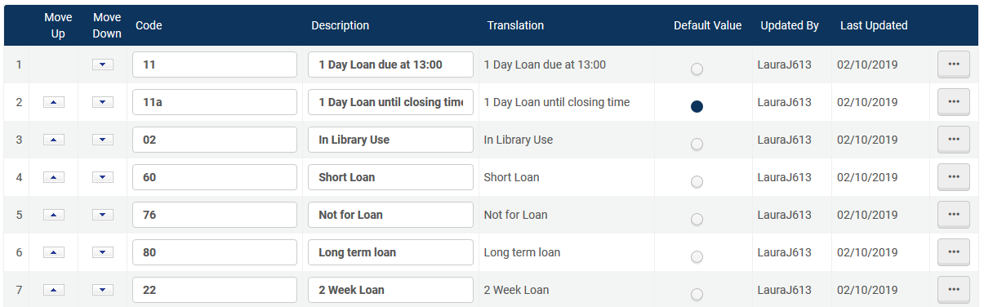
Define an item policy "Not for loan"
We already have a policy which is called "Not for loan"

Slide 8
Define a terms of use (TOU) "Not for loan"

Slide 9
Define a terms of use (TOU) "Not for loan"
Go to: "Configuration > Configure for institution > Fulfillment > Physical Fulfillment > Terms of use and policies"
See if there is already a row for a TOU "Not for loan".
If there is already a policy then no need to do anything
If there is not already a policy then add one

Slide 10
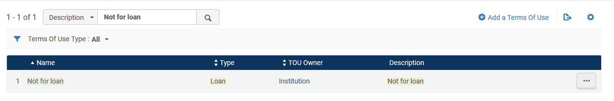
Define a terms of use (TOU) "Not for loan"
We already have a TOU which is called which is called "Not for loan"
We will edit the TOU and make sure that it is not only called "Not for loan" but also really defined to not allow loans

Slide 11
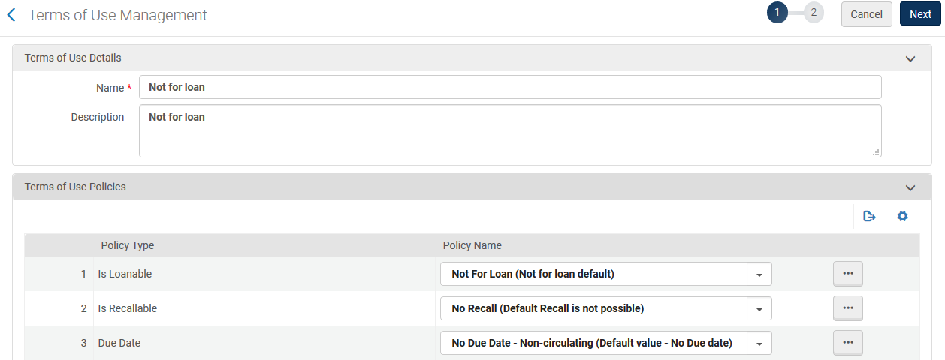
Define a terms of use (TOU) "Not for loan"
It really is defined as "Not for loan"

Slide 12
Make a fulfillment unit rule connected to the TOU and policy

Slide 13
Make a fulfillment unit rule connected to the TOU and policy
Create a fulfillment unit rule which will use the "Not for loan" TOU when the item policy is "Not for loan"
This should be done at "Configuration > Configure for institution > Fulfillment > Physical Fulfillment > Fulfillment Units"
Switch to the "Fulfillment Unit Rules" tab and be sure it is filtered by type "Loan"
Add a new rule (or edit an existing one)
Have the rule link to the TOU "Not for loan"
Put the rule in the first place in the list of rules.

Slide 14
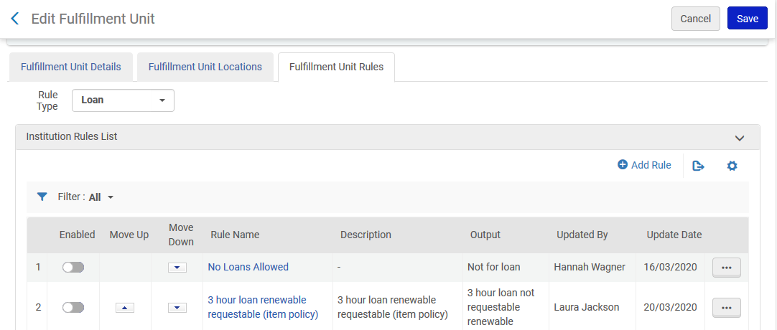
Make a fulfillment unit rule connected to the TOU and policy
Add a rule here or edit an exist rule

Slide 15

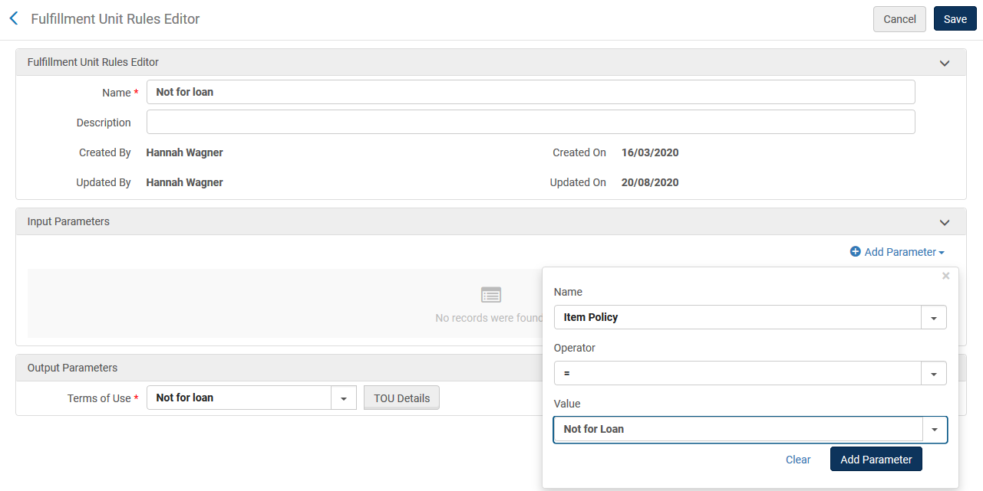
Make a fulfillment unit rule connected to the TOU and policy
We define:
If item policy = "Not for Loan" then use TOU "Not for loan".

Slide 16
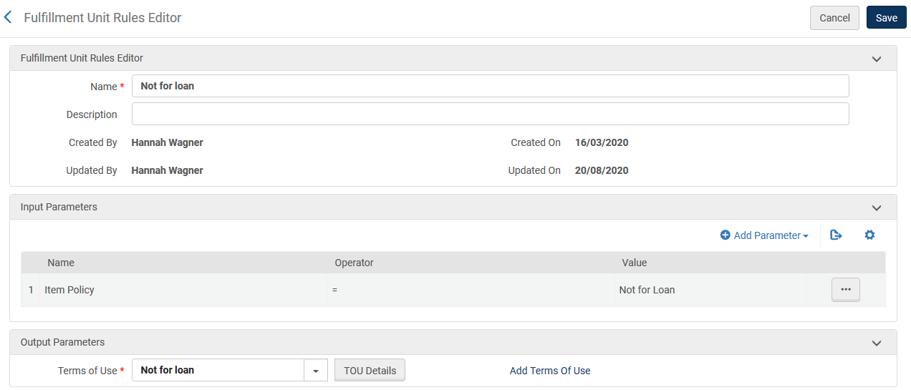
Make a fulfillment unit rule connected to the TOU and policy

Slide 17
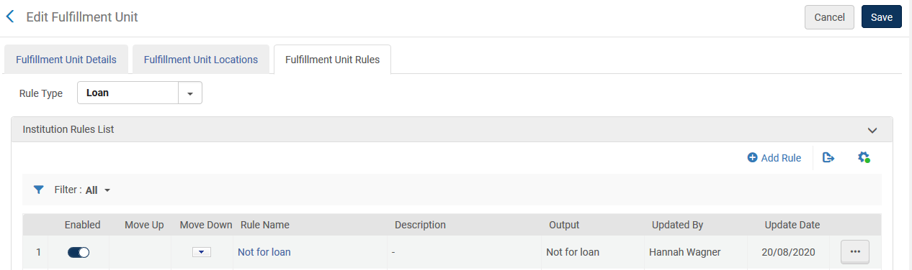
Make a fulfillment unit rule connected to the TOU and policy
Put the "Not for loan" rule at the top of the list so that it will for sure be used (and another condition will not first be met)

Slide 18
Test it out

Slide 19
Test it out
In the example here we will test the configuration by manually updating one item.
After confirming that the configuration is as desired it is possible to globally update a set of items.
To globally update a set of items see "Change physical items" at Running Manual Jobs on Defined Sets

Slide 20
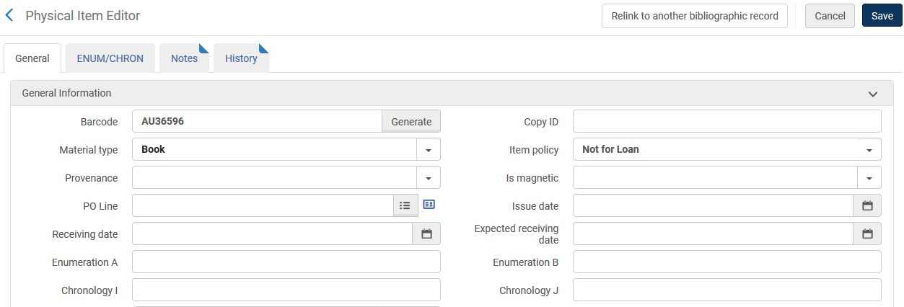
Test it out
We will attribute this item policy to barcode AU36596

Slide 21
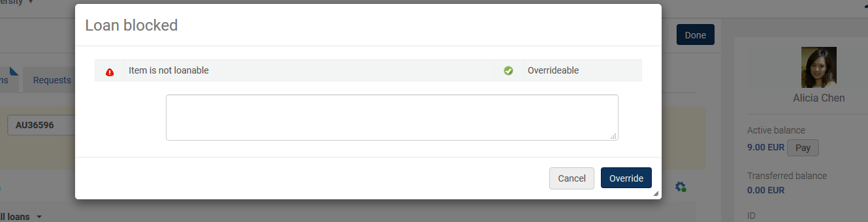
Test it out
Try to loan this item and see that it is blocked

